Slide 1
Sepal Research
Larry & Stephanie Kraft
Research Department
Sepal Brazil
May 2003
I, wisdom, dwell together with prudence;
I possess knowledge and discretion.
- Proverbs 8:12

Slide 2
“The most important thing is to keep
the most important thing
in the place of most importance.”
- ancient German proverb
We believe that in order to maintain
the focus of our ministry on what is
most important (in our work toward
completing the Great Commission)
we need:
GOOD INFORMATION:
RESEARCH

Slide 3
Why we emphasize research:
It gives us credibility in the eyes of the church
It helps us make wise decisions
It encourages the wise use of our resources
It aids us in the implementation of well-informed
and focused strategies
It provides information necessary for the
motivation, training and mobilization
of the church to reach the entire country

Slide 4
A Bíblical Model:
Then I said to them, “You see the trouble we are in: Jerusalem lies in ruins, and its gates have been burned with fire. Come, let us rebuild the wall of Jerusalem, and we will no longer be in disgrace.” I also told them about the gracious hand of my God upon me and what the king had said to me.
They replied, “Let us start rebuilding.” So they began this good work.
Nehemiah 2:17-18

Slide 5
Integrity without knowledge is weak and useless,
and knowledge without integrity is dangerous
and a cause for concern
-Samuel Johnson (1709-1784)
Information can be used by the enemy when it is:
Incomplete
Incorrect
Poorly interpreted
Example: Exaggerations are
used by the enemy to take
away the church’s motivation
for the evangelistic task.
We can use data to say anything we want.
The key question is, “What does God want to
say to His church through the information
at hand?”

Slide 6
The Purpose of Research in Sepal:
Perceive what the Holy Spirit is doing and where He is leading the Church, so that we can cooperate with Him and be better used by God in His harvest.

Slide 7
Top Priority: Assist the Sepal Team
Understand the church and its context
Discover ministry areas in which the
Brazilian Church most needs assistance
in order to be able to grow and multiply
and reach the entire country
Seek to discern the right time for the right
ministry
Discover effective ministry methods and
models
Provide information for the evaluation of
ministry objectives and for decision making
regarding the opening and closing of fields
and areas of ministry

Slide 8
Researching the needs of church Leaders:
Surveys at pastors’ conferences
Group consultation with pastors
Interviews with pastors and
church leaders
Surveys in magazines and
leadership journals

Slide 9
Researching the Evangelical Leadership
Subjects of most interest in the purchase of books
ministry tools
theology
family
counseling
Bible commentaries
missions
devotionals
biographies
others
Survey of readers of Leadership Jornal 2001

Slide 10
Factors which affect the decision to participate
in training events
theme
speaker
price
location
date
timeframe
sponsoring
organization

Slide 11
Most sought-after themes or subjects
family
discipleship
church growth/planting
counseling
missions
theological questions
inner healing
Bible studies
spiritual warfare
evangelism
sermons
small groups
youth work
prayer ministry
controversial subjects
others

Slide 12
Contextual Research
This type of research focuses on factors
which affect the reaching of the country
Religious
Ethno-linguistic
Sociological
Political
Economic
Geographic/Demographic
Historical
Cultural

Slide 13
Brazil’s Religious Context
Population: 170 million
Land mass: 8.5 million sq. km.

Slide 15
External Research:
Evaluate the potential of the church
to disciple the nation
Highlight needs
Expand the leaders’ vision
Seek out change agents
Identify effective ministry models
Attempt to discern God’s timing
for mobilizing the church

Slide 16
NO-502

Slide 18
Researching the Church:
Where are the churches?
How many churches are there?
Who is being reached?
How is the church growing? Where
is the church growing or not and why?
What is the future potential for
church growth?
What is the receptivity of the different
ethnic groups and geographic regions?
How is the church progressing as a
as a missionary sending force?

Slide 19
Church XYZ
Church
Growth
Consultations
(annual growth rate in members)
40%
30%
percentage
20%
Church XYZ
10%
(membership projections)
3000
0%
1983
1984
1985
1986
1987
1988
1989
2500
year
past
members
2000
AAGR 30%
1500
AAGR 20%
AAGR 10%
1000
500
1985
1986
1987
1988
1989
1990
1991
1992
1993
1994
year

Slide 20
Teaching and evaluation on:
Church growth principles
The health of local churches
The local church in missions
Our focus has moved away from these areas in recent years due to other groups beginning to minister in these areas.

Slide 21
Church Multiplication:
The Churches
of Ipiranga
A survey of all of the streets of the neighborhood during 1998 and 1999 located 75 Protestant churches of all denominations. The population to church ratio was one church for every 2,533 people.
Sepal - Depto. de Pesquisas
February 2000
(11)5523-2544

Slide 22

Project
Marília
2002

Slide 23
PROJECT MARÍLIA 2002
Summary of Research Results
Population of Marília: 187.804
Number of Protestant churches: 134
Average attendance: 106 people per church
Percentage of the population in church on Sunday: 7,5%
Population to church ratio: 1402
(one geographic region had 5253 inhabitants per church)
Churches with 100 or less in attendance: 71%
Churches with more than 250 in attendance: 7%

Slide 24
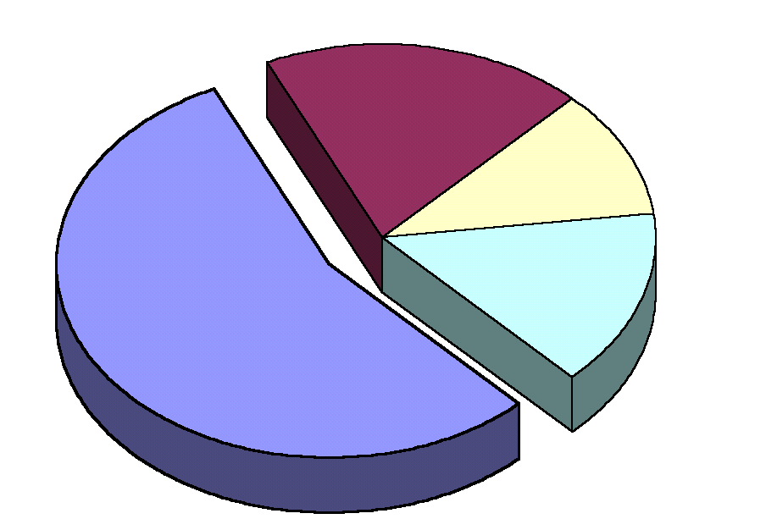
Religious Institutions of Marília
(percentage of total meeting places)
Catholic Churches
(19%)
Spiritist centers or
esoteric religions (11%)
Others (15%)
Protestant Churches (55%)
Projeto
Marília
2002 -- Sepal / Projeto Brasil2010 / Igreja Evangélica das Nações - março de 2002 -
info
@brasil2010.
org
/
ien
@terra.com.br

Slide 26
Marília
2002
Population per church in each geographic region
12000
10000
8000
No Churches
Inhabitants per local church
6000
5253
4000
2271
1639
1776
2000
1360
869
1159
714
0
Centro
Leste 1
Leste 2
Norte 1
Norte 2
Oeste 1
Oeste 2
Sul 1
Sul 2
geographic region
Projeto
Marília
2002 -- Sepal / Projeto Brasil2010 / Igreja Evangélica das Nações - março de 2002 -
info
@brasil2010.
org
/
ien
@terra.com.br

Slide 27
l

Slide 28
Marília
2002
percentage of the population attending church
35,0%
30,0%
28,8%
25,0%
20,0%
15,0%
10,0%
7,1%
6,9%
5,0%
4,6%
5,2%
4,6%
4,2%
1,3%
0,0%
0,0%
Centro
Leste 1
Leste 2
Norte 1
Norte 2
Oeste 1
Oeste 2
Sul 1
Sul 2
geographic region
Obs
.: porcentagem da população
residente em cada região geográfica da
cidade presente nas igrejas
evangélicas
no culto principal da semana
Projeto
Marília
2002 -- Sepal / Projeto Brasil2010 / Igreja Evangélica das Nações - março de 2002 -
info
@brasil2010.
org
/
ien
@terra.com.br

Slide 29
O
e
N
o
C
e
N
o
L
e
L
e
s
t
e
r
t
e
n
t
r
r
t
e
s
t
e
s
t
e
_
1
_
2
o
_
1
_
2
_
S
1
u
O
e
l
t
l
_
2
_
2
O
e
N
o
C
e
N
o
L
e
L
e
s
t
e
r
t
e
n
t
r
r
t
e
s
t
e
s
t
e
_
1
_
2
o
_
1
_
2
_
l
1
_
1
S
u
s
t
e
l
t
t
l
l
l
O
e
s
t
e
C
e
_
1
n
t
r
o
L
e
s
t
e
_
2
S
u
l
_
2

Slide 32
Brazil
Percent Protestant by Geographical Region
1980 -- 2002
Sepal Research 2002 <pesquisas@sepal.org.br> Source: IBGE – Demographic Census

Slide 33
Brazil
Protestant Growth Rate by Region
1980 -- 2000
Sepal Research 2002 <pesquisas@sepal.org.br> Source: IBGE – Demographic Census

Slide 34
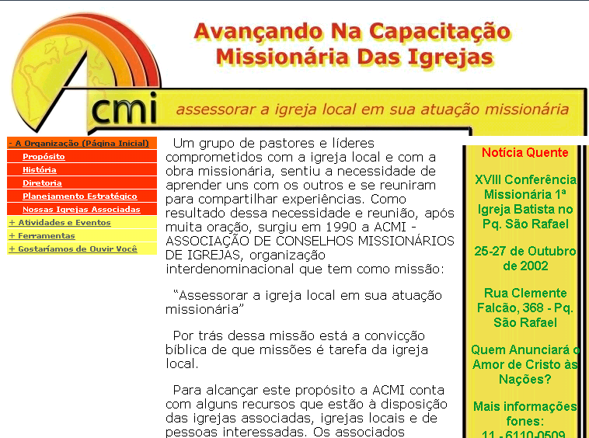
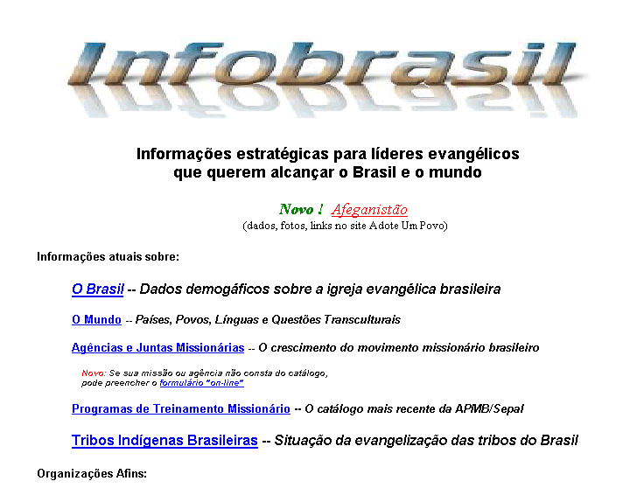
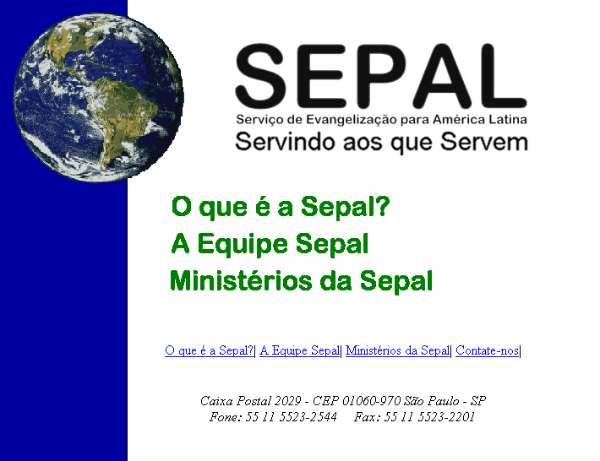
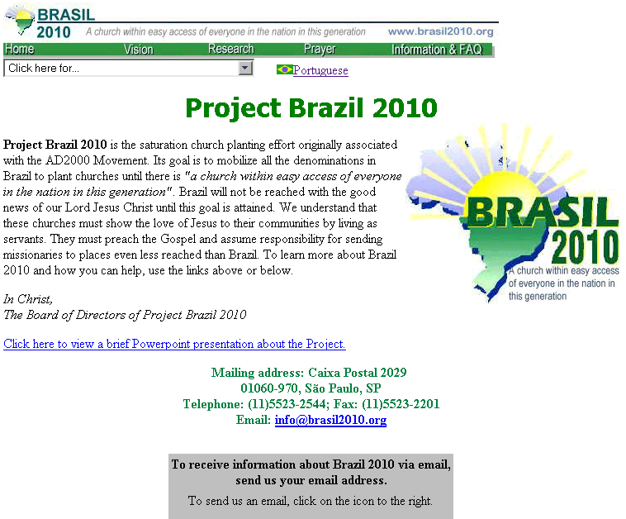
www.acmi.org.br
www.infobrasil.org
www.sepal.org.br
www.brasil2010.org

Slide 35
It is not good to have zeal without knowledge,
nor to be hasty and miss the way.
- Proverbs 19:2

